Slide 1

Python Crash Course
Anshu Bantra
Please install Python from https://anaconda.com/download

Slide 2
What Is
General Assembly?

Slide 3
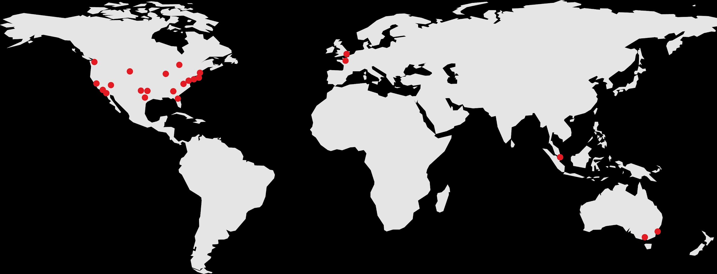

What began as a co-working space in 2011
has since grown into a global learning
experience with 20+ campuses and more
than 70,000 alumni worldwide.
Atlanta | Chicago | Houston | Melbourne | Paris | San Diego | Singapore | Toronto
Austin | Dallas | London | New York City | Phoenix | San Francisco | Stamford | Washington, D.C.
Boston | Denver | Los Angeles | Orlando | Providence | Seattle | Sydney
‹#› | © 2018 General Assembly

Slide 4

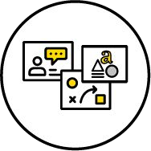
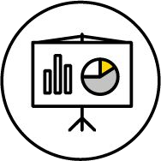

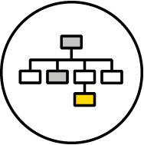

What We Teach
Coding
UX & Design
Data
Marketing
Business
Career Development
‹#› | © 2018 General Assembly

Slide 5

About Me
Anshu Bantra
Senior Analyst, Bushfire Recovery Victoria
Started my career as a software engineer, however, over time realized my love for data and moved over to using data to get insights.
Love teaching and sharing my knowledge.
Working with GA since 2015.
I have worked extensively with various SQL’s, Excel, VBA, Python, etc. (Also, some extinct ones like Pascal & Fortran ☺)
Based in Melbourne
3 | © 2019 General Assembly

Slide 6


ABOUT YOU
Discussion:
Introduce yourself:
Name
What you do for work
Why you’re here today!
What Languages have you coded in?
None!, Excel, SQL, HTML, BASH/DOS, C, Python, etc.
How will this course help you with your goals?
‹#› | © 2018 General Assembly

Slide 7

About this course
Learning Objectives
Discuss the history of Python & how it’s used in diﬀerent industries
Describe the beneﬁts of a Python workﬂow when looking at data
Demonstrate basic Python programming fundamentals to solve a real world problem
Create a custom learning plan to build your data science skills after this workshop!
‹#› | © 2018 General Assembly

Slide 8
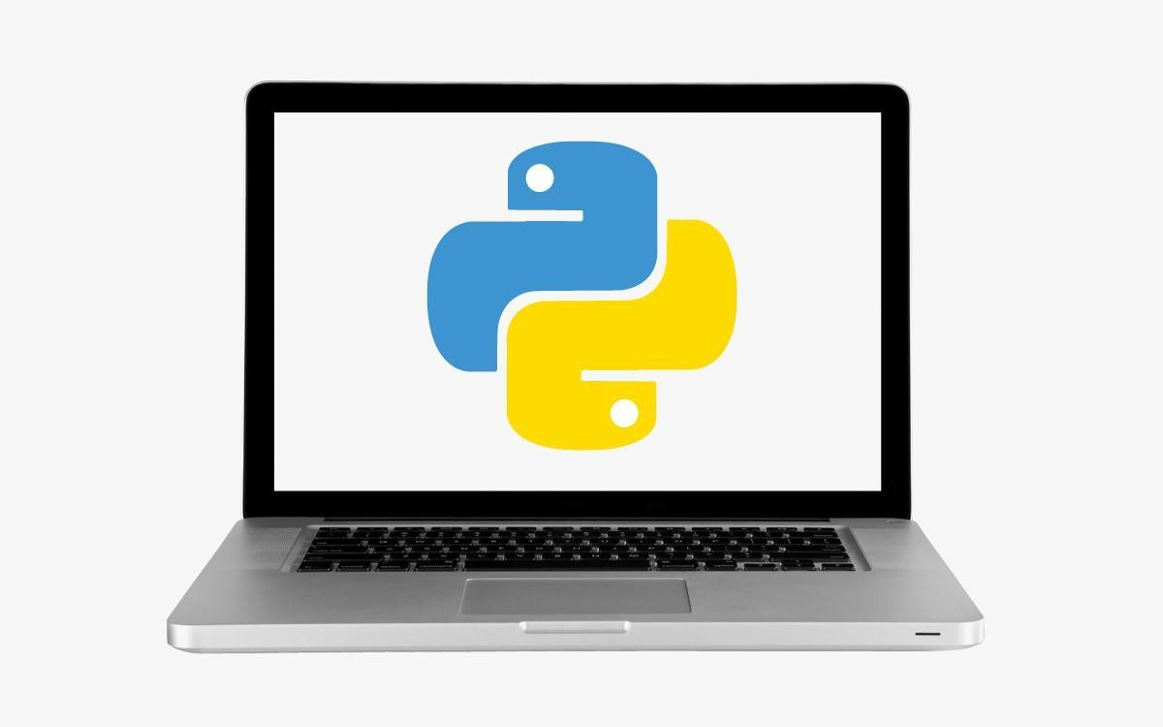
About this course
Getting the most out of this course
Make sure you have the tools you need running smoothly
Think / ask how Python could ﬁt into your workﬂow
The exercises are guidelines, pursue your interests in during practice
Plan how you will continue your learning
‹#› | © 2018 General Assembly

Slide 9
Today dozens of G“oogle engineers use
Python, and we're looking for more people with skills in this language.
Peter Norvig,
Director of search quality at Google, Inc.
‹#› | © 2018 General Assembly

Slide 10
What Is Python?
Intro to Python

Slide 11

What is Python?
Python is a programming language.
What is a Programming Language?
A way to communicate with computers.
Why Python?
Easy to pick up and learn
Emphasizes productivity and code readability
Easier for many to contribute to production level code
‹#› | © 2018 General Assembly

Slide 12
Why is Python readable
Interpreted language:
Step by step execution for easier programming ideation
Write once, run anywhere
Performance tradeoﬀ
Object-oriented (OO)
Code with objects that contain data and functions to manipulate it in predeﬁned ways
High-level programming
Use natural language syntax where possible
‹#› | © 2018 General Assembly

Slide 13
Why Python?
Free, Flexible, and Open Source
Rapid prototyping and full-stack commercial applications
Extensible with easy to install libraries
Great documentation
Established and growing community
Scripts can be run many times
When data changes
On diﬀerent machines
At diﬀerent times
‹#› | © 2018 General Assembly

Slide 14






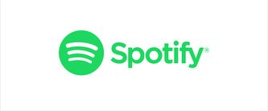

Who uses Python?
Real Cases:
‹#› | © 2018 General Assembly

Slide 15
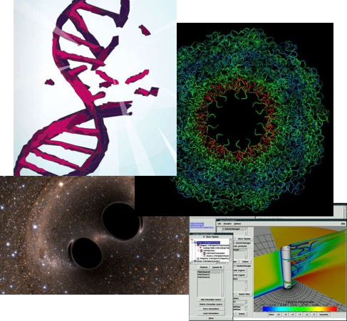
Examples
Real Cases:
Industry
Drug discovery
Financial services
Films and special eﬀects
Academia
Gravitational waves
Scientiﬁc visualisation
Biomolecule simulation
More
Success Stories
‹#› | © 2018 General Assembly

Slide 16
Storytime
Discussion:
How will you use python?
Job or Industry
Workﬂow Improvements
Dream Projects
‹#› | © 2018 General Assembly

Slide 17
No great marketing“decisions have ever
been made on qualitative data.
John Sculley,
Former VP PepsiCo + CEO Apple
‹#› | © 2018 General Assembly

Slide 18
Exploring Python With Anaconda
Intro to Python

Slide 19
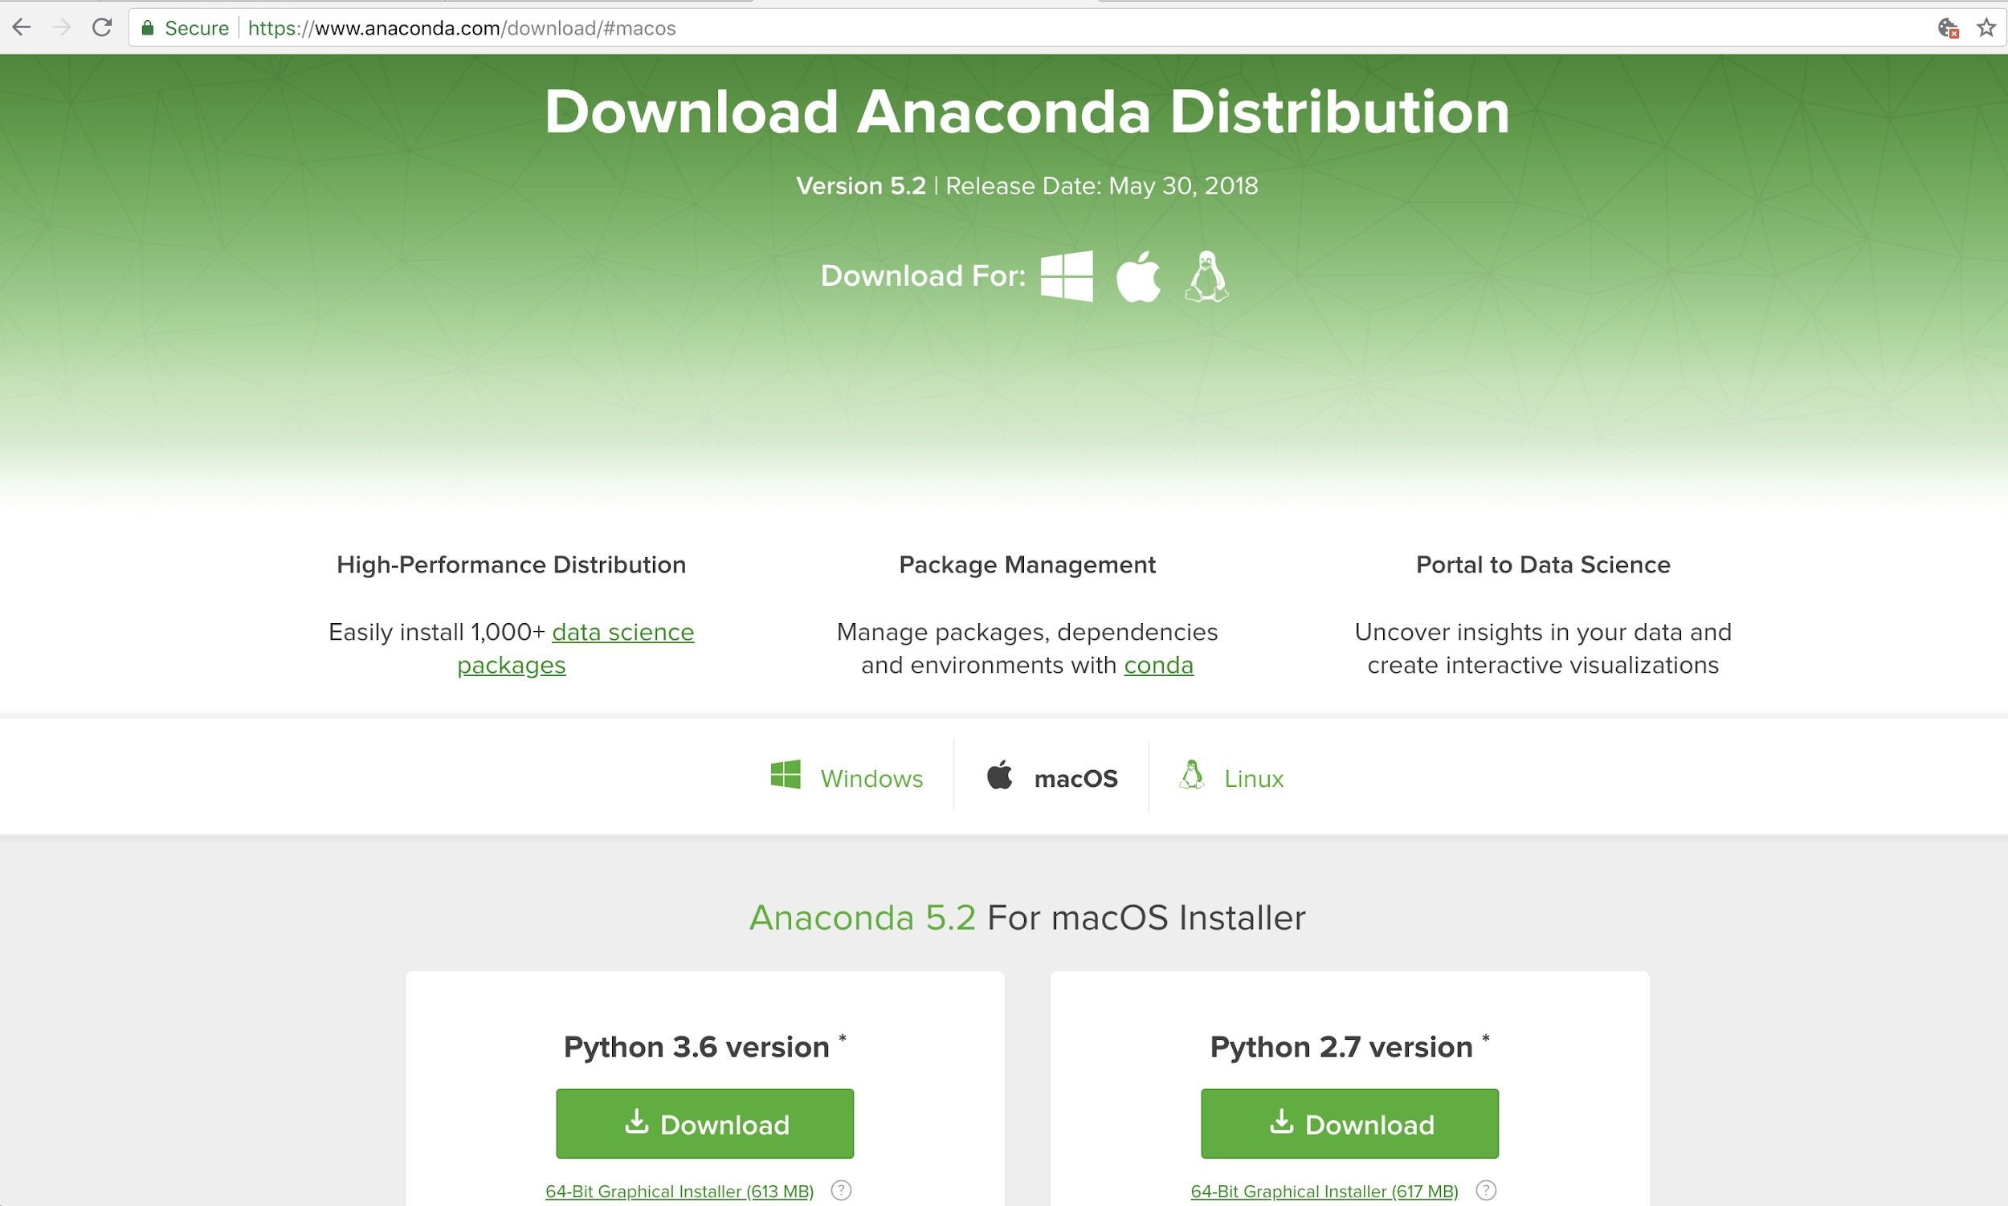
Download Anaconda https://anaconda.com/download
‹#› | © 2018 General Assembly

Slide 20
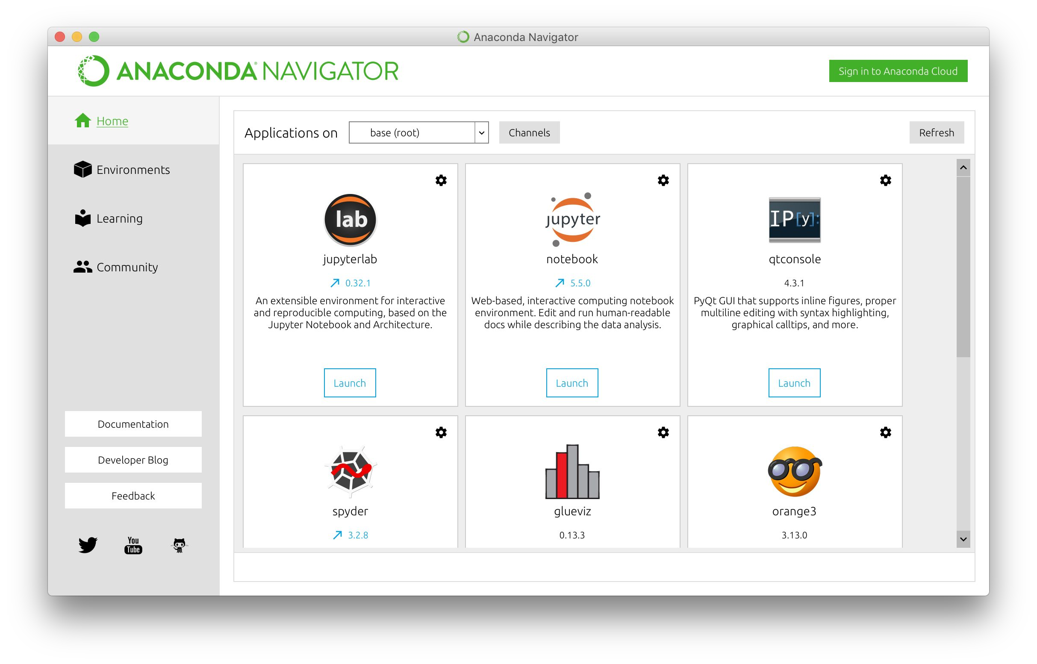
Anaconda Navigator
‹#› | © 2018 General Assembly

Slide 21
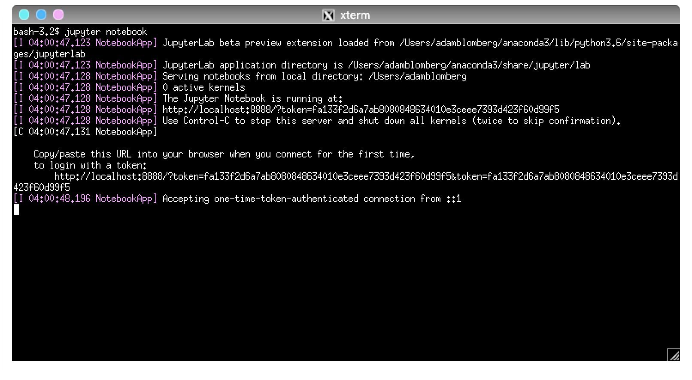
Terminal / Anaconda Prompt
‹#› | © 2018 General Assembly

Slide 22
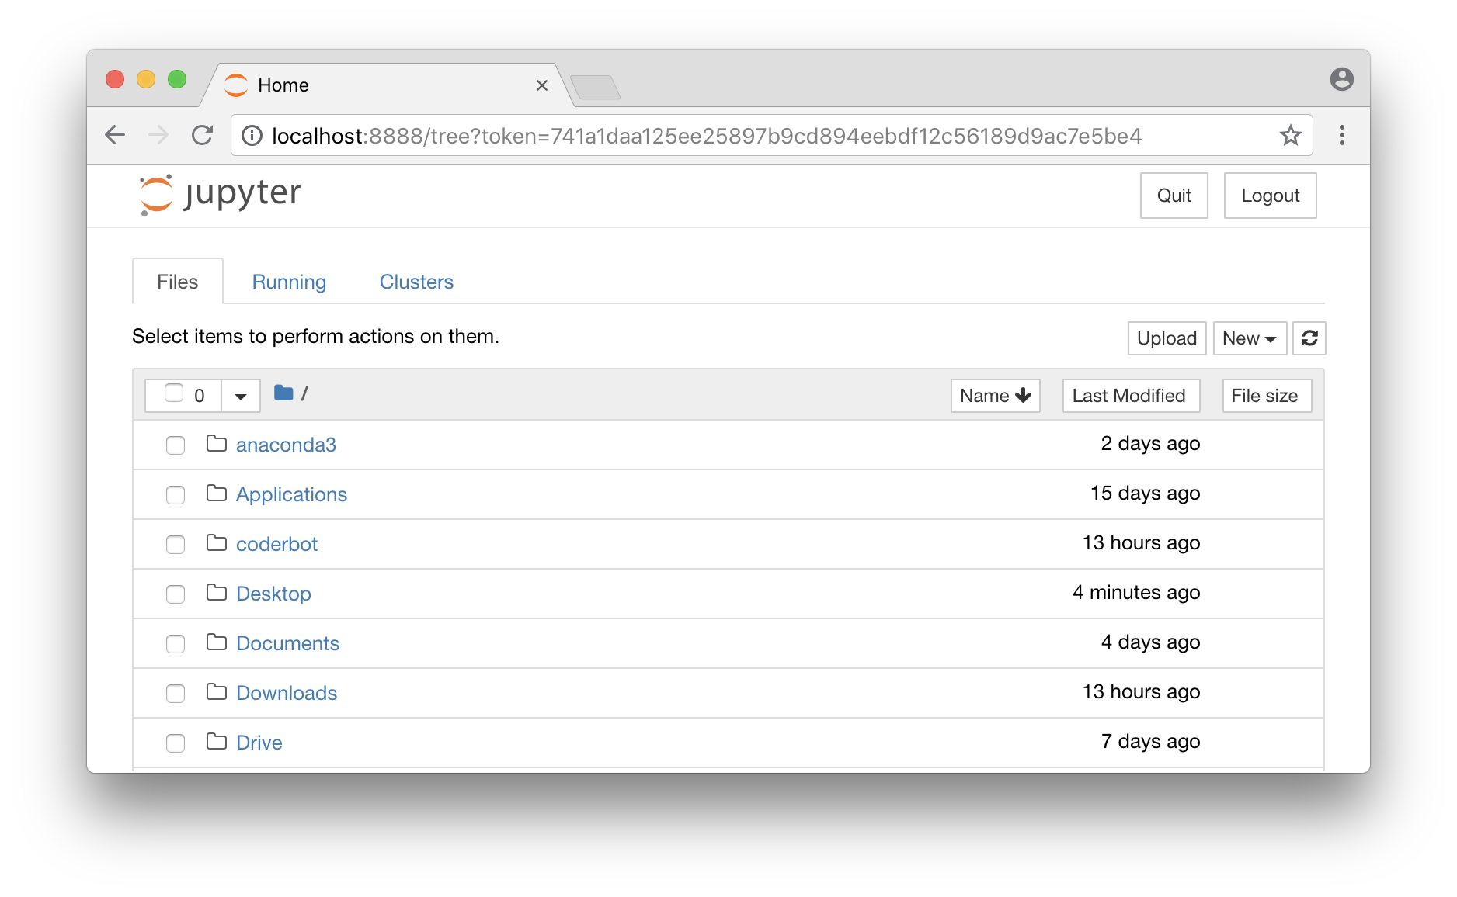
New Web Browser window with personal ﬁles
‹#› | © 2018 General Assembly

Slide 23
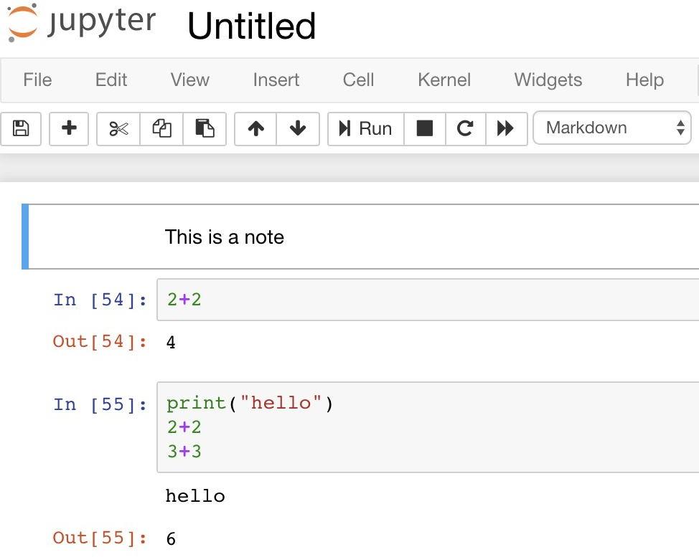
Jupyter Notebook
Cells:
Markdown for notes
Code for Python
Modes
Blue for commands
Green for editing
Execution
Ctrl + return
Shift + return
Output
Print (all)
Return values (last)
‹#› | © 2018 General Assembly

Slide 24
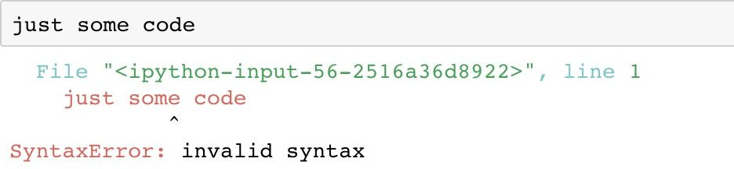
Jupyter Notebook errors
Mistakes happen! Here’s what they look like:
Try to understand what went wrong
Attempt to ﬁx the problem
Execute the cell again

Slide 25
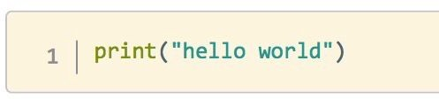
Python programming
Let’s see what a Python program looks like.
We’ll start with the classic "Hello World!" program:
This code will print the message "Hello World!" on the screen.

Slide 26
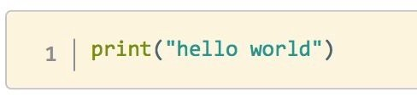
What did we just see?
Data
“hello world”
string
Denoted by quotation marks
Single ‘...‘
Double “...”
Triple “””...”””
Function
Print
Aside: # makes comments

Slide 27

5 minutes
Solo Exercise:
Try out Jupyter notebook
Take some time to try out Jupyter notebook.
Make sure you can:
Convert cells between Markdown and Code
Edit and execute a note cell
Edit and execute a code cell
Try to do some math
Make an error

Slide 28
We wrote more cod“e in python than we
were expecting, including all [the] in-game screens and the main interface.
Soren Johnson,
Lead designer on Civilization IV, Firaxis Games

Slide 29
Python Programming Fundamentals
Intro to Python

Slide 30
Programming Fundamentals Framework
Every programming language can be broken down into core components. Having a general framework for this context will help us learn speciﬁcs for Python.
Syntax
The structure of the commands given to the computer
Variables
How computers store information
Control Structures
Sets the hierarchy/priorities of programming logic
Data Structures
How computers organize data

Slide 31
Syntax
The syntax of a programming language is the set of rules that deﬁne the combinations of symbols that are considered to be correctly structured programs in that language
Just like our spoken languages have structures like paragraphs and sentences, programming languages have code blocks and statements.

Slide 32
Variables
Variables are symbolic names that store a speciﬁc piece of information. Variables come in diﬀerent types in order to hold diﬀerent kinds of information.
For example: max_temp = 15
Deﬁnes a variable: named “max_temp”
This holds a numerical integer: 15
For example: temp_unit = “Deg. C”
Deﬁnes a variable: named “temp_unit”
This holds a non numerical value: Deg. C

Slide 33
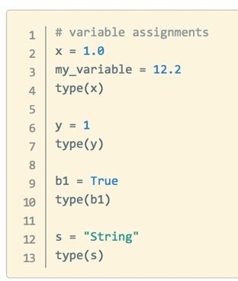
Variables
Types
Bool - 1 or 0, True or False
Int - number w/o decimal point
Float - number w/ decimal
String - text
Assignment
○ = operator deﬁnes variable
Variable names
snake_case
Lowercase Letters, Numbers, Underscores
type() function - shows data type

Slide 34
Variables
Operators - combine data
○ +, -, *, / (add, subtract, multiply, divide)
○ +=, -=, etc ( perform operation and save result)
** (power)
//, % (quotient, remainder (modulus))
>, <, ==, !=, <=, >= (greater than, less than, equal, not equal, etc)
Functions and methods - saved instructions to manipulate data
abs(my_int) - function_name(data)
len(my_string)
my_string.lower() - data.method_name()
my_int. add (5)
“Dunder” - double underscore ( ) = important Python built in item

Slide 35
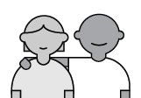
5 minutes
Partner Exercise:
Practice in Jupyter notebook
Now you try! Pair up with a partner to attempt the following in your notebooks. Help each other out!:
Create variables
Bool
Int
Float
String
Check their class with type()
Try out some operations on your variables
What works? What causes errors?

Slide 36
10 minutes
Solo Exercise:
Working with Variables
Let's work together and make some “Variable Magic”
Print a line saying your name, country of birth and where are you currently, as below: Hi I am Anshu, I was born in India. Currently I am based in Melbourne.
Create a cell which calculates the sum of 3 numbers
Check what happens if you use a “Variable”, that does not exist
What happens when we do math operations with strings (Non-Numbers / Alpha Numeric)
What happens when we do math operations between strings & numbers
Check data type of different type of variables.

Slide 37
Booleans
Booleans have only two values, i.e.: True or False.
Boolean algebra is the branch of algebra in which the values of the variables are the truth values true and false, usually denoted 1 and 0, respectively.
For example: 1 = 2
This results in a False
For example: age = 32; age > 25
Deﬁnes a variable: named age with value 32
This results in a True

Slide 38
10 minutes
Solo Exercise:
Working with Variables
Let's work together and make some “Variable Magic”
What will print ( ‘a’ > ‘Z’ ) return?
If I had a=4 & b=5, what would print( a = b ) return
How would you check is a is not equal to b
bool method | Truthy & Falsy | 0 & 1 | Empty Variables
and __ or ~~~ & __|

Slide 39
Control Structures
A block of programming that analyses variables and chooses a direction in which to go based on given parameters is a control structure.
The term ﬂow control details the direction the program takes (how program logic “ﬂows”). It determines how a computer will respond when given certain conditions and parameters. Some typical structures include:
If statements
For loops
Functions

Slide 40
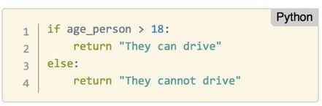
Control Structures
If / elif / else
Check conditions with boolean operators (i.e. <, >, ==)
Execute a single code block depending on result
If True: code runs
Can be:
if alone
f/else
if/elif(s)/else
Indentation controls end of if block
Data controls which code runs

Slide 41
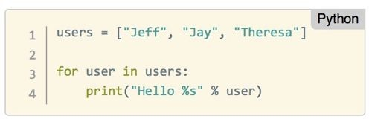
Control Structures
for loop
Repeat operations
Loop variable takes each value from list in turn
Indentation controls end of loop
Watch out for inﬁnite loops!
Interrupt or restart kernel when this happens

Slide 42
15 minutes
Solo Exercise:
Working with Control Structures
Let's work together and make some “Decisions”
Write a conditional to read variable temp. If temp is greater than 25 then print, let’s go to the beach, if it is 25 or lower print Netflix it is.
Write a conditional to read variable temp. If temp is greater than 30 then print, let’s go to the beach, If temp is greater than 15 then print, let’s go for a walk, if it is 15 or lower print Netflix it is.
Get user input for number and print out if it is odd or even.
Assign value to two variables, check if they are numbers, if either is not print a message. If they are numbers print which is greater than the other, or if they are equal
Assign a string to variable and loop over the characters of the string

Slide 43
Data Structures
A data structure is a particular way of storing and organizing data in a computer so that it can be used eﬃciently.
Some examples in Python include:
Lists
Tuples
Dictionaries
Dataframes

Slide 44
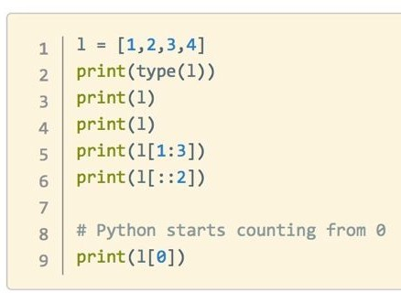
Data Structures
Lists
A collection of objects
Mixed types are okay
Deﬁned with square brackets [ ]
They can be modiﬁed
my_list.append()
my_list.insert()
my_list.remove()
my_list.pop()
List Index
Slicing
Access elements
my_list[ start : end : step ]
Functions / Loop with List

Slide 45
15 minutes
Solo Exercise:
Working with Lists
Let's work together with some “Lists”
Create a list of all classmates => mates.
Print length of list.
Print 2nd name on list.
Delete 1st name in the list and add to variable name_removed.
Add the name deleted in step 3, to the end of list.
Remove the added name from last location.
Re-add the name at 1st location.
For Loop with Lists
Loop through the list of mates and print “Welcome to the class, <mate name>”
Loop through the list of mates and print names which have ‘a’ in the name
Loop through the list of mates and print first ‘n’ names from the list

Slide 46
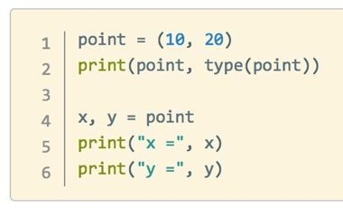
Data Structures
Tuples
very similar to lists, but:
They are deﬁned with parentheses ( ) instead of square brackets
They cannot be changed
No append() method
No remove() method
Slicing works the same way

Slide 47
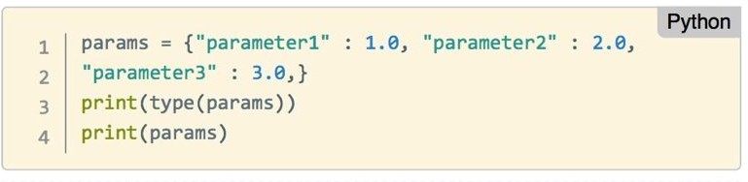
Data Structures
Dictionaries
Collections of key/value pairs
Deﬁned by curly brackets { }
Slicing uses keys
Order is not preserved

Slide 48
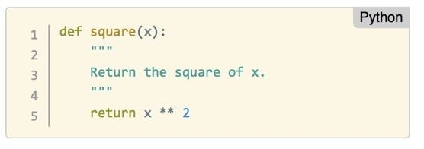
Control Structures
Functions
Groups of instructions repeat / create abstractions of common tasks.
Divide our code into useful blocks
Provide order, making the code more readable and reusable
def name(input1, input2, …) :
First line is “Document String” describing how function works
Deﬁnition saves instructions only - no execution!

Slide 49
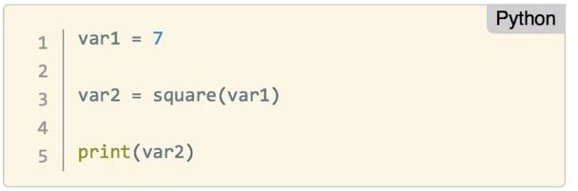
Control Structures
Functions
Run functions with parentheses after the name
Needs to be deﬁned before it can be executed!
The return value is saved in var2
Other functions can be run on the result!

Slide 50
15 minutes
Solo Exercise:
Working with Functions
Let's work together with some “Fucntions”
Create a function to add 3 numbers.
Create a function to print first ‘n’ odd numbers.
Create a function FIZZBUZZ
# Write a function that prints the numbers from 1 to 101.
# But, for multiples of three, print “Fizz” instead of the number.
# For multiples of five, print “Buzz”.
# For numbers which are multiples of both three and five, print “FizzBuzz”.

Slide 51
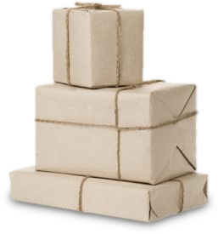
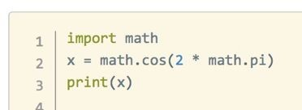
Expanding python
Packages
Install new libraries to add functionality to Python: conda install <name>
or
pip install <name>
Use packages by importing them into your Python scripts

Slide 52

Real Cases: Expanding python
Common Packages
Data manipulation: pandas, Numpy, scipy
Machine Learning: scikit-learn, nltk
Databases: psycopq2, sqlalchemy
Visualizations: matplotlib, plotly, bokeh
API calls / web scraping: requests, BeautifulSoup, Scrapy
Web development: Django, Flask, Twisted, Scapy
Game Development: Pygame, Pyglet
Desktop App: pyQt, Tkinter
More
47 | © 2018 General Assembly

Slide 53
I have students le“arn Python in our
undergraduate and graduate Web courses. Why? Because there's nothing else with the ﬂexibility or as many
pre-built libraries...
Prof. James A. Hendler, Univ. of Maryland
48 | © 2018 General Assembly

Slide 54
Python Programming Practice!
Intro to Python

Slide 55
Lets go here to Practice!
https://github.com/kasun-maldeni/intro-to-python
‹#› | © 2018 General Assembly

Slide 56
The goal is to“turn data into
information, and information into insight.
Carly Fiorina,
Former CEO, Hewlett-Packard
‹#› | © 2018 General Assembly

Slide 57
Let’s Review
Intro to Python

Slide 58
Review and Recap
In this workshop, we've covered the following topics:
Python as a popular, ﬂexible programming language
Python has applications in many diﬀerent areas
Python is particularly great for data manipulation
Python programming basics include: types, variables, functions, and more!
53 | © 2018 General Assembly

Slide 59
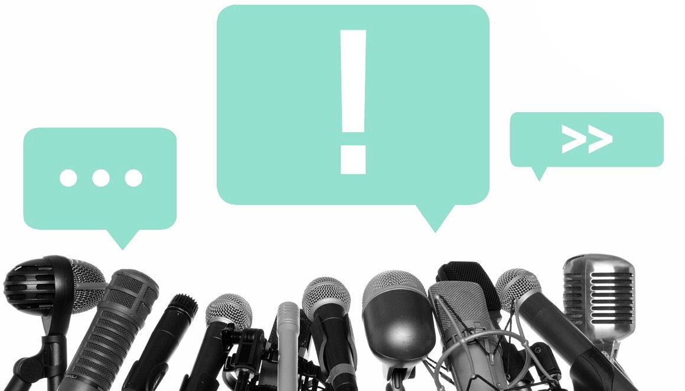
Ask Me Anything!
54 | © 2018 General Assembly

Slide 60
We appreciate your feedback!
Please take 60 seconds to complete our survey.

Slide 61
Homework
Intro to Python

Slide 62
Homework Exercises
Work through at your own pace!
Lab 1
Lab 2
Lab 3 (OOP)
57 | © 2018 General Assembly

Slide 63
THANK YOU!
See you next week!

Slide 64
Next Steps
Intro to Python

Slide 65
Create a learning plan
What’s next?
Solidify your learning:
Go through the parts of Learn How to Think Like a Computer Scientist.
Familiarize yourself with the language by going through A Beginner's Python Tutorial.
Practice Practice Practice! Problems to expand your skills are available at:
HackerRank
CodeWars
‹#› | © 2018 General Assembly

Slide 66
Create a learning plan
General Assembly also oﬀers courses that teach you how to use Python!
Check out our:
Part-time Data Science Course
Data Science Immersive Course
Online Part-time Data Science Course
Part-time Python Course
Online Part-time Python Course
‹#› | © 2018 General Assembly

Slide 67

A Few Good References
Oﬃcial Python Documentation
PEP-8 Oﬃcial Guide
Anaconda Tutorials
Jupyter Documentation
Example Notebooks
62 | © 2018 General Assembly

Slide 68


